Slide 1

MTA Data Analysis of NYC Subway for WTWY
By Eddy, Yingzhao and Ashvine
17 April 2020

Slide 2

Objectives
Our goal is to help WTWY teams in achieving maximum email signups.
This will help them increase their fundraising on the gala night.

Slide 3



Methodology
Using the New York City subway data to analyse transit patterns of commuters in order to optimize WTWY team placement.
Ten weeks’ worth of turnstile data from the MTA datasets
For each station, we added both their entry and exit data for a combined traffic data.
Data analysis with the following:

Slide 4

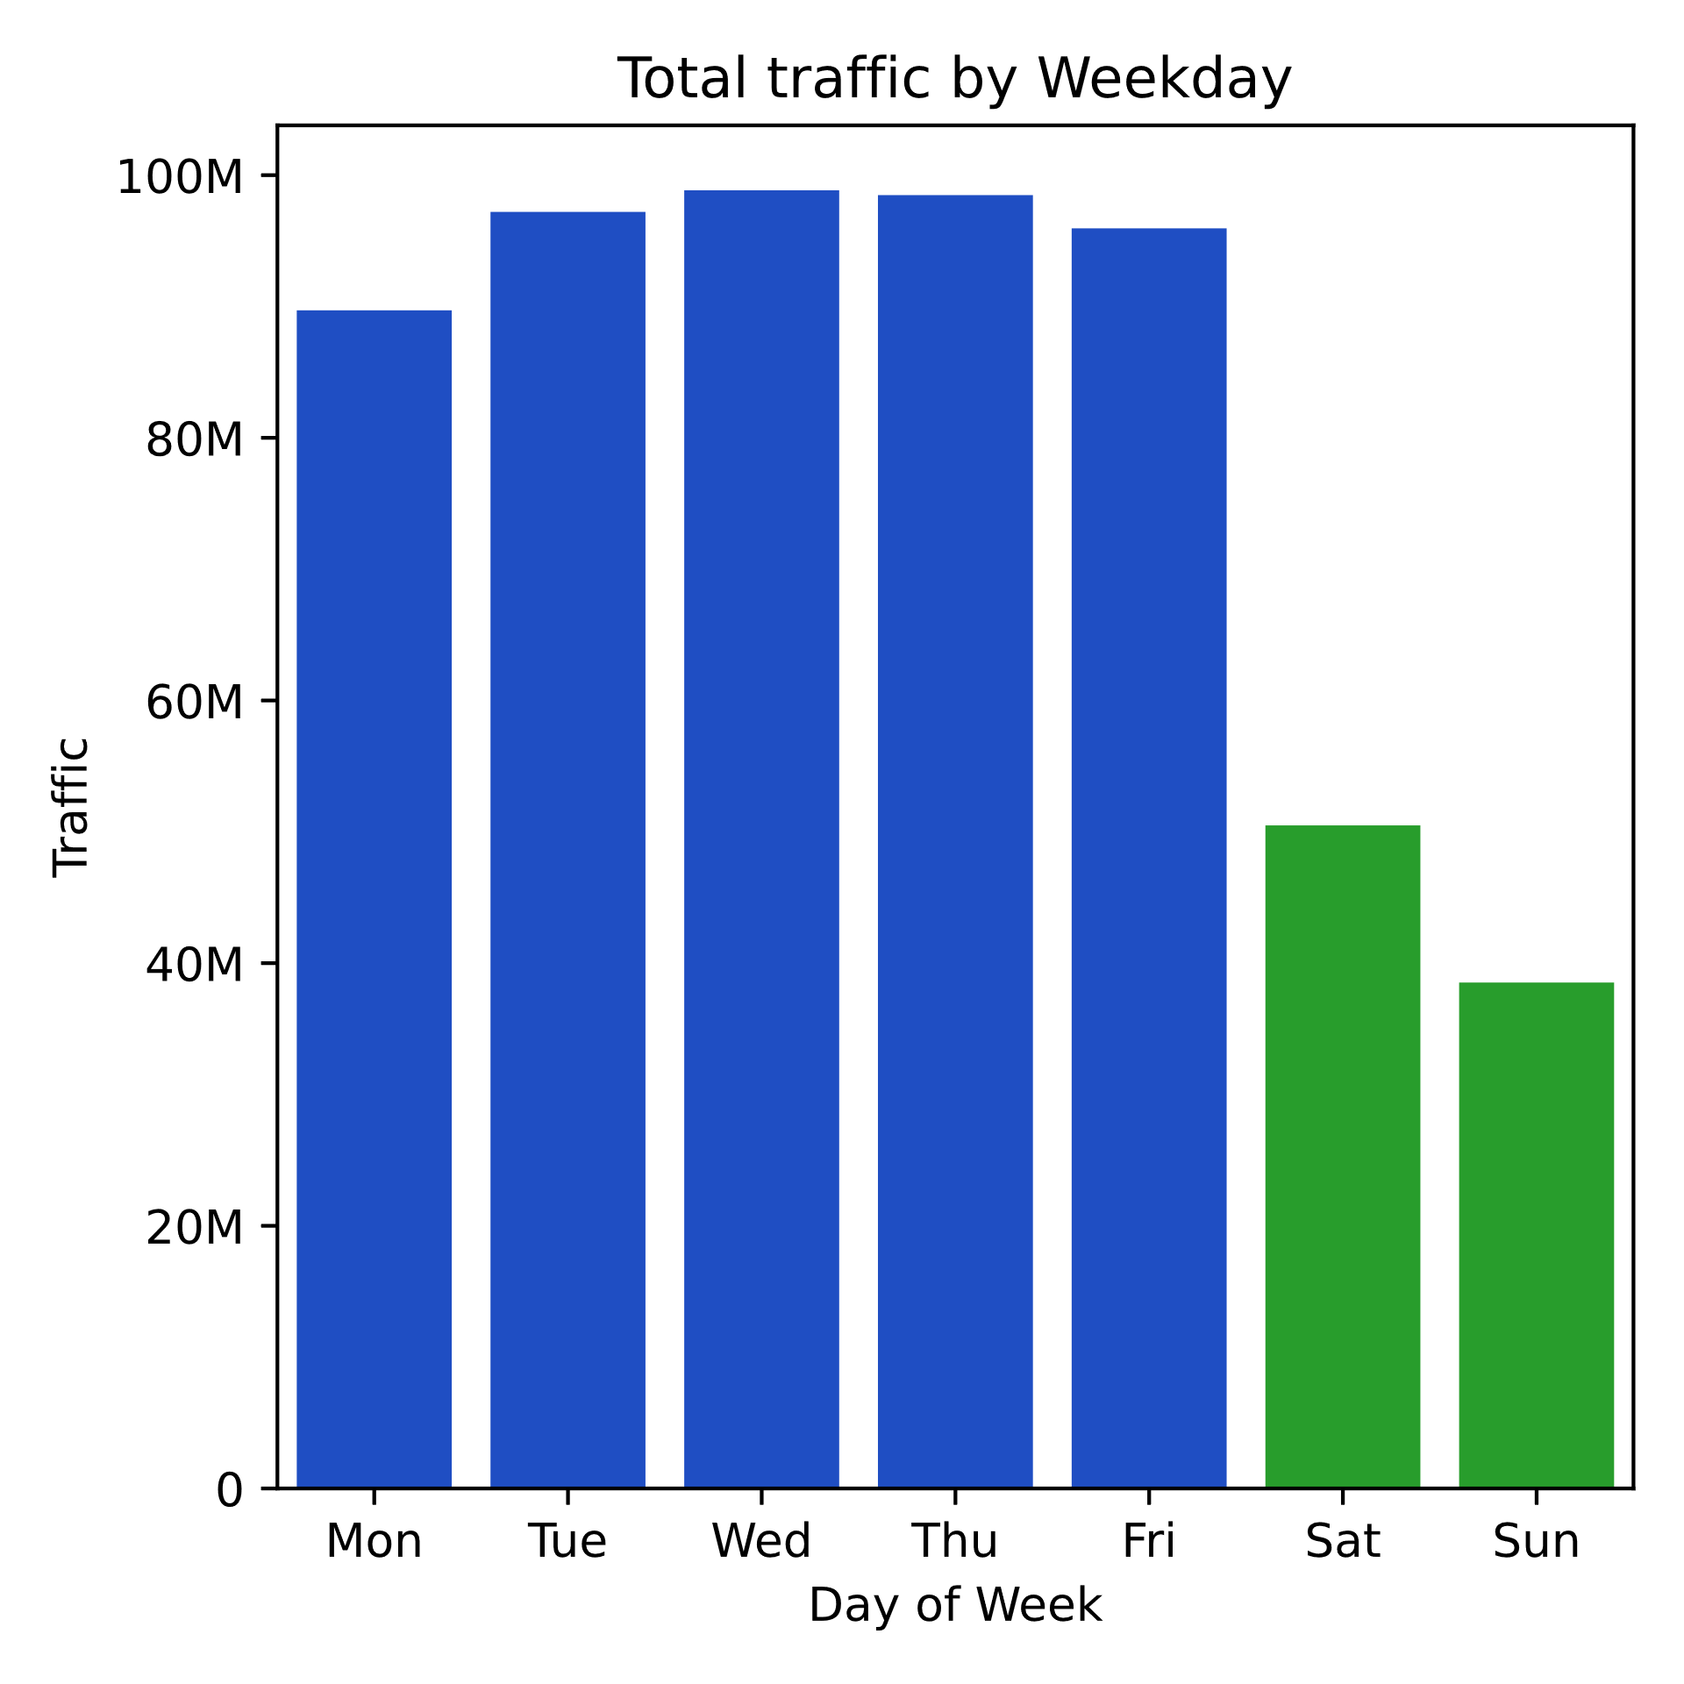
Key Findings
All MTA NYC Stations
(26 Jan 2019 – 5 April 2019)
Weekends generally see less traffic
Weekdays generally see more traffic

Slide 5
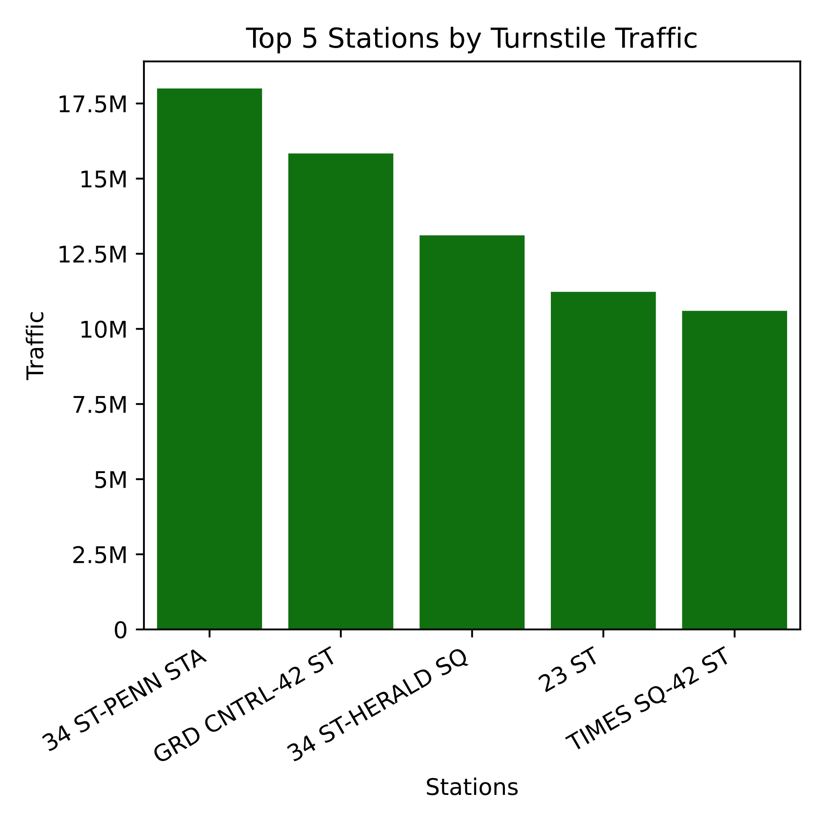
Key Findings
26 Jan 2019 – 5 April 2019
Top stations are the following:
Penn Station
Grand Central
Herald Square
23rd Street
Times Square
Focus on these stations

Slide 6
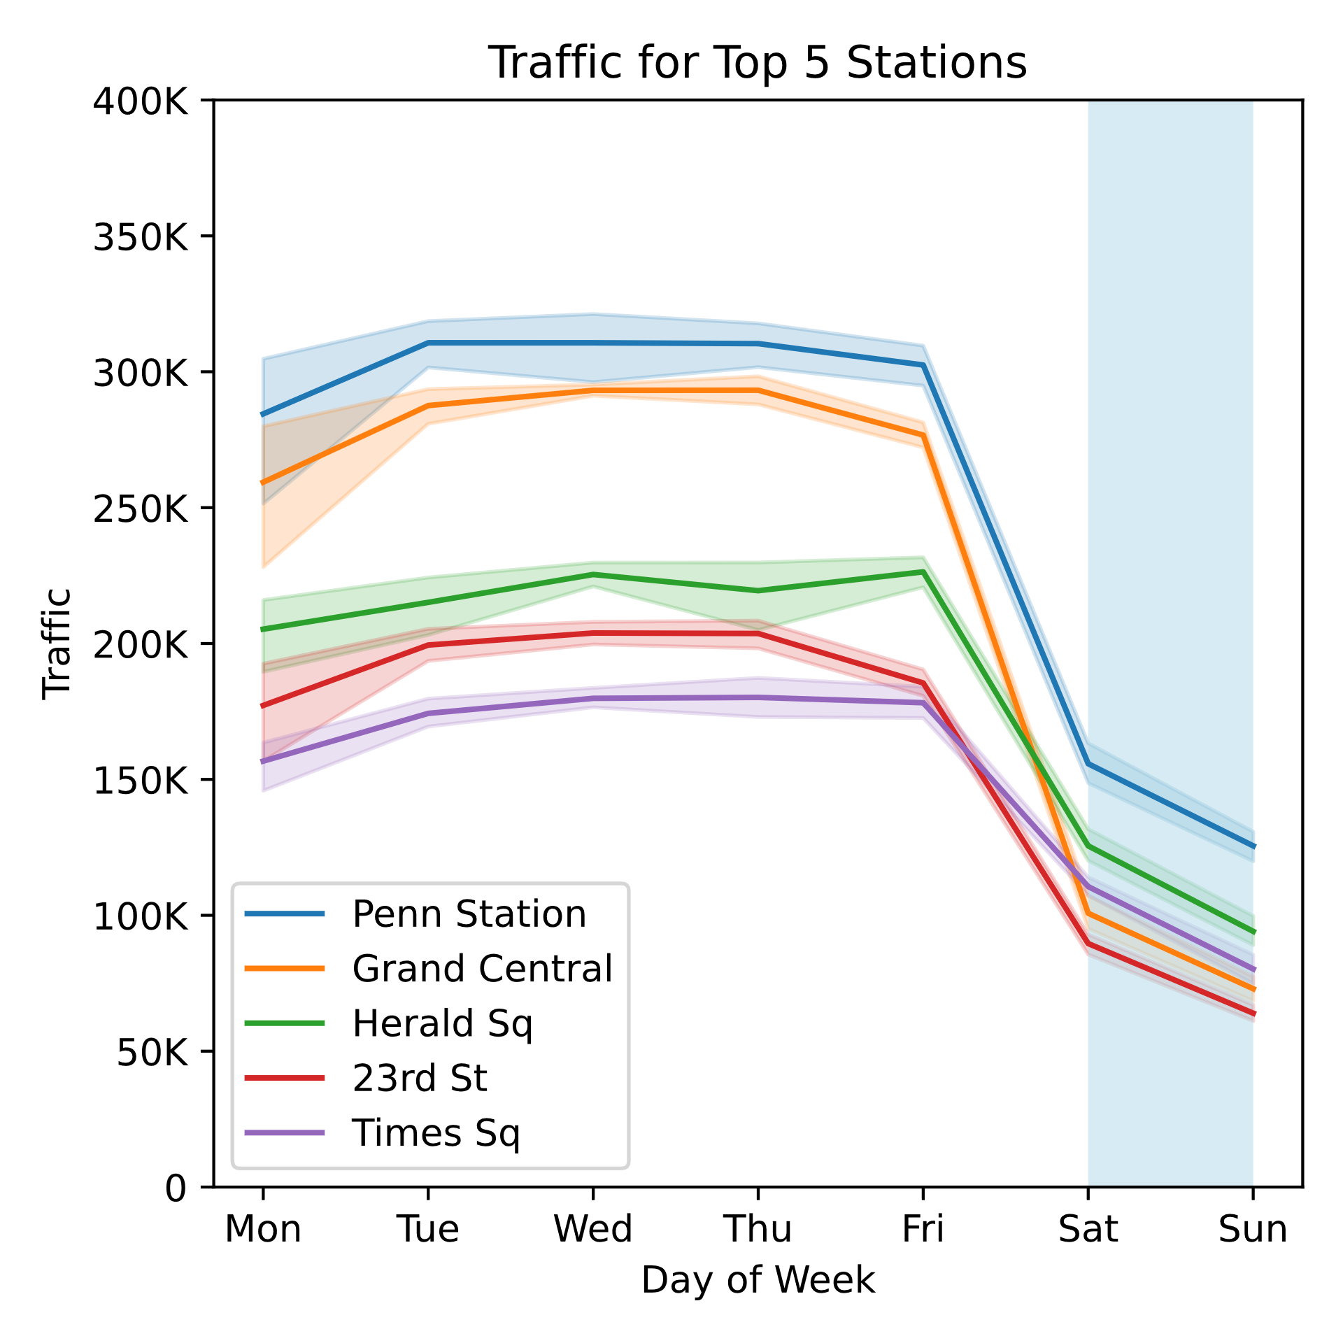
Key Findings
26 Jan 2019 – 5 April 2019
All five stations have similar patterns of traffic
Low on weekends (blue highlight)
High on weekdays
Larger variations on Mondays
Focus on weekdays

Slide 7
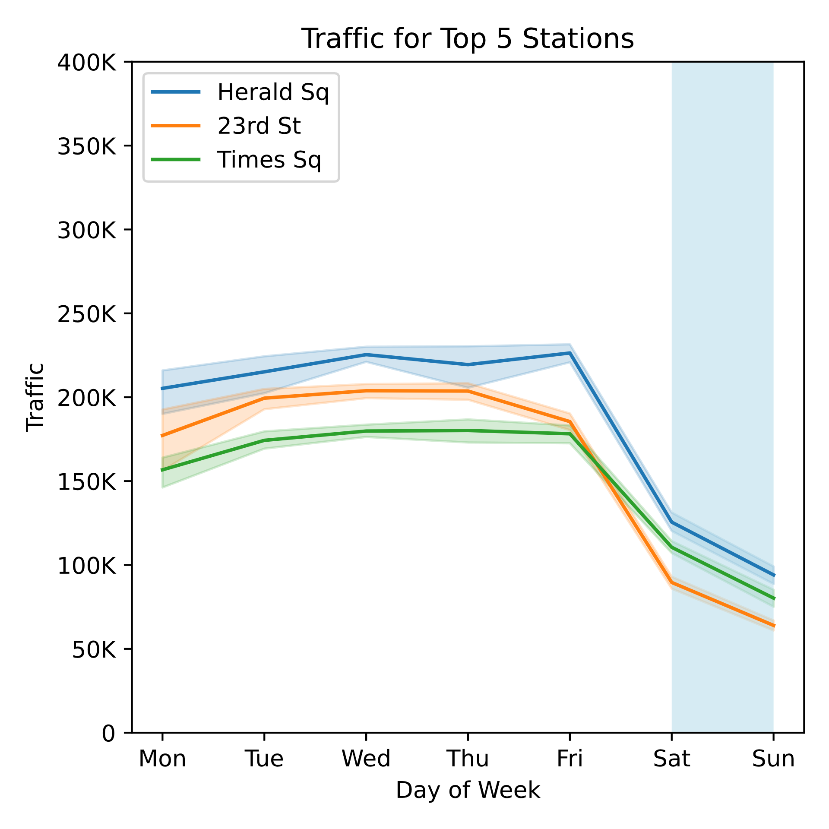
Key Findings
26 Jan 2019 – 5 April 2019
Some stations have flatter traffic patterns than others
Could be in or near tourist areas
Tourists unlikely to attend conference
May be better to skip these stations
… and go for the 6th – 8th ranked stations

Slide 8
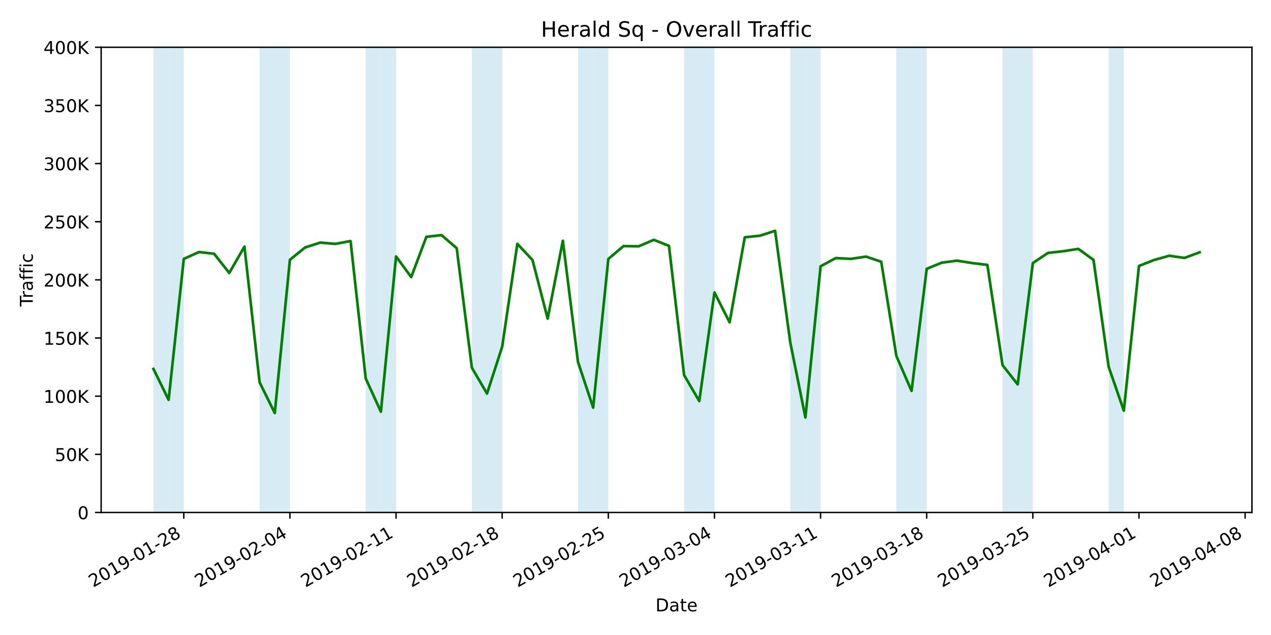
Key Findings
26 Jan 2019 – 5 April 2019
Certain weeks for certain stations have anomalous dips or peaks
Could be due to special circumstances
Need to determine what causes these dips/peaks before making any decision

Slide 9

Next Steps: Identify 3 more areas…
Top Month
Top Stations
Peak Hours

Slide 10



…to support Women Tech Women Yes

Slide 11

Thank You

Slide 12
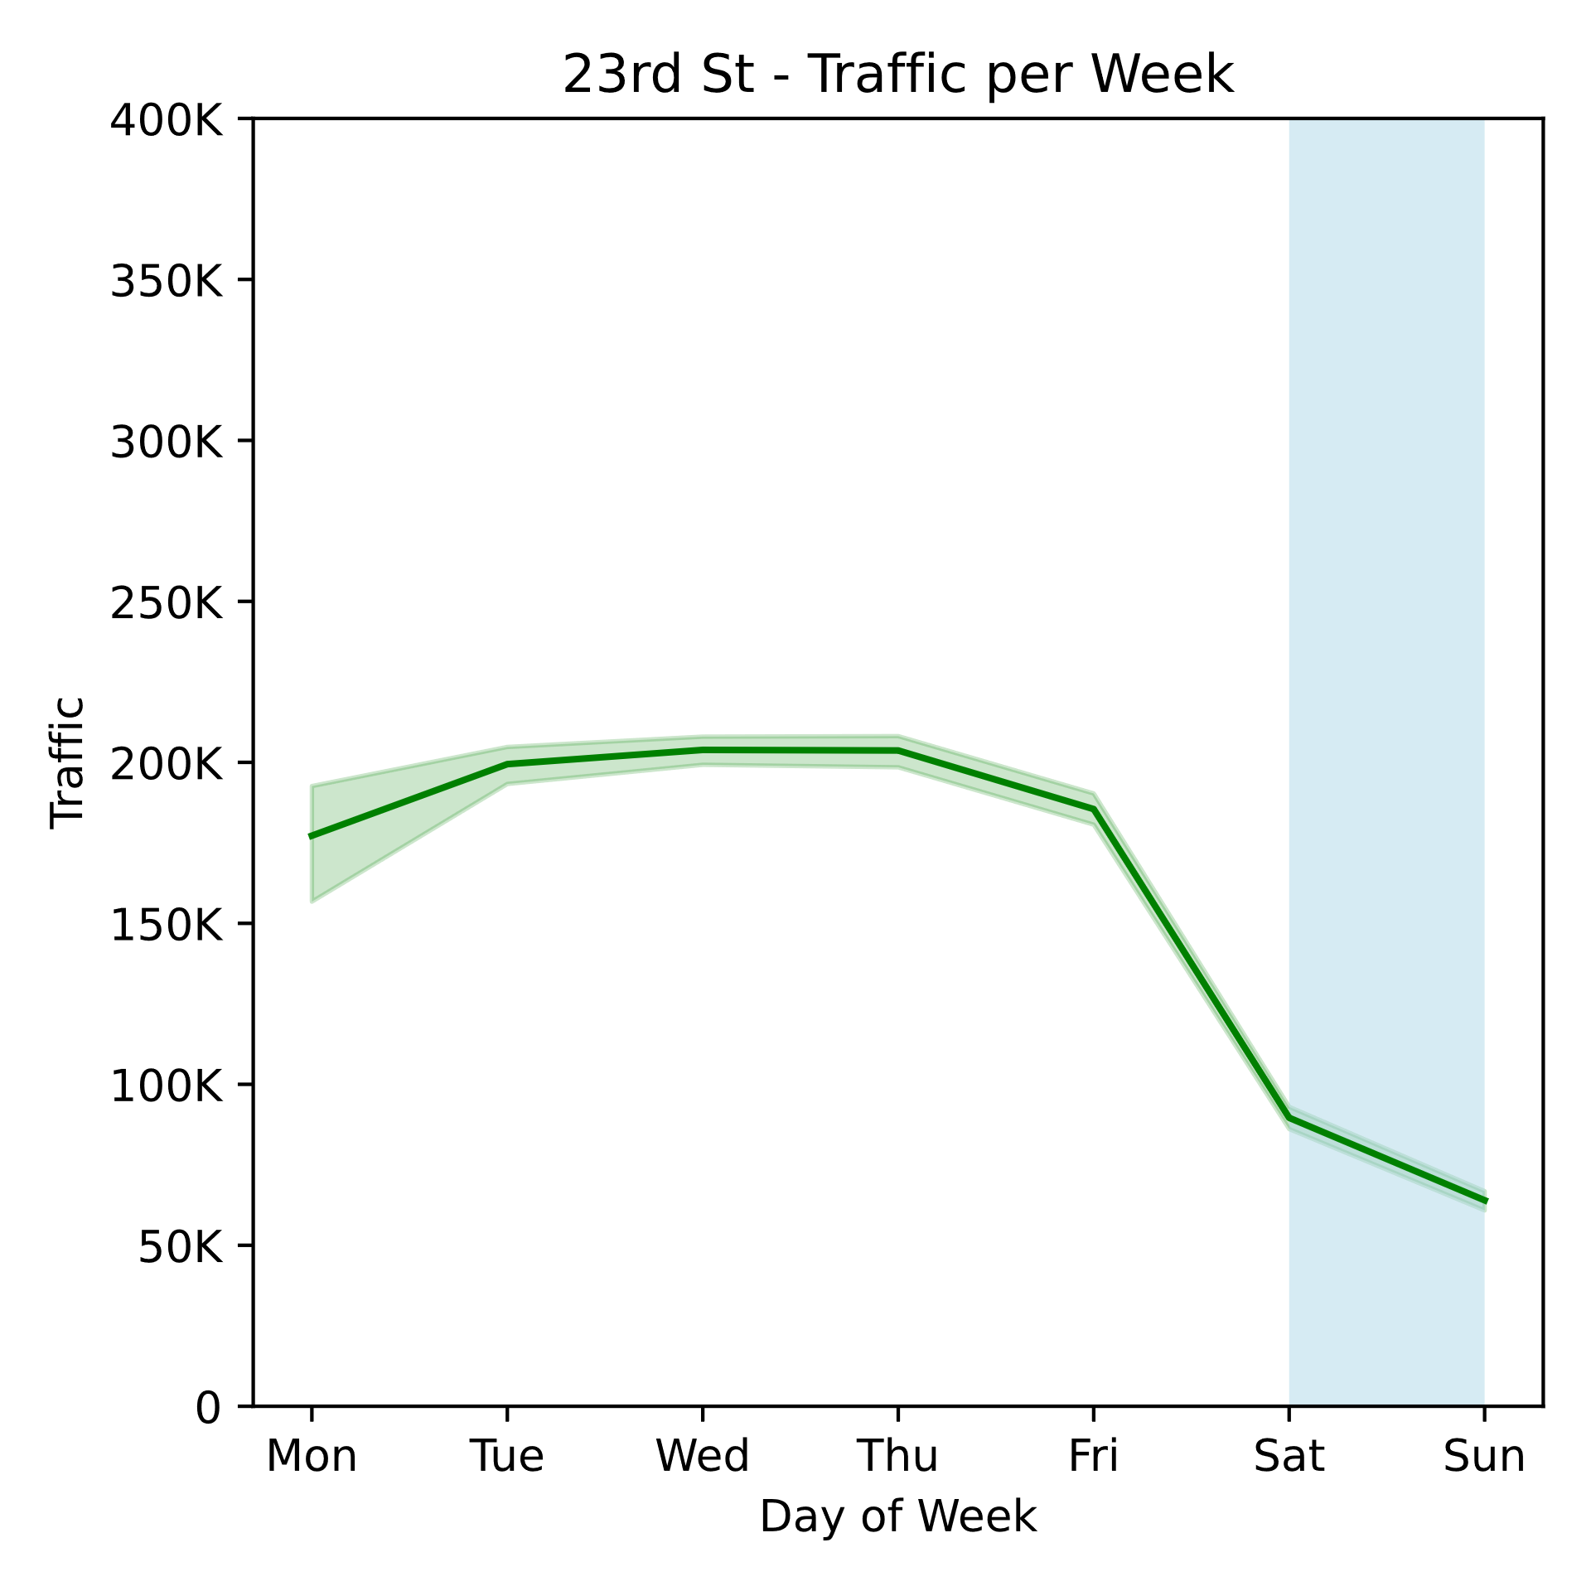
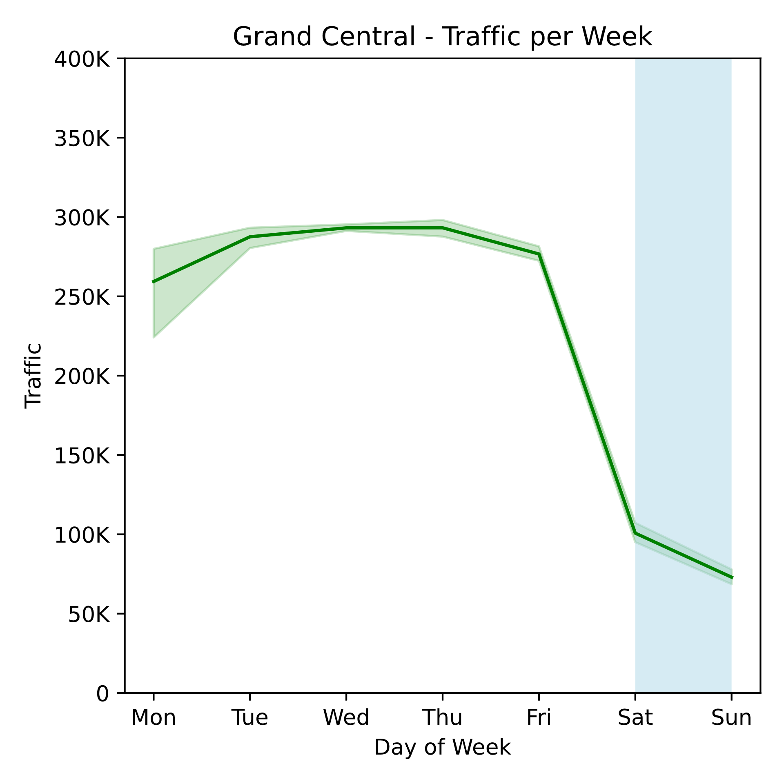
Appendix 1 – Entries for each station

Slide 13
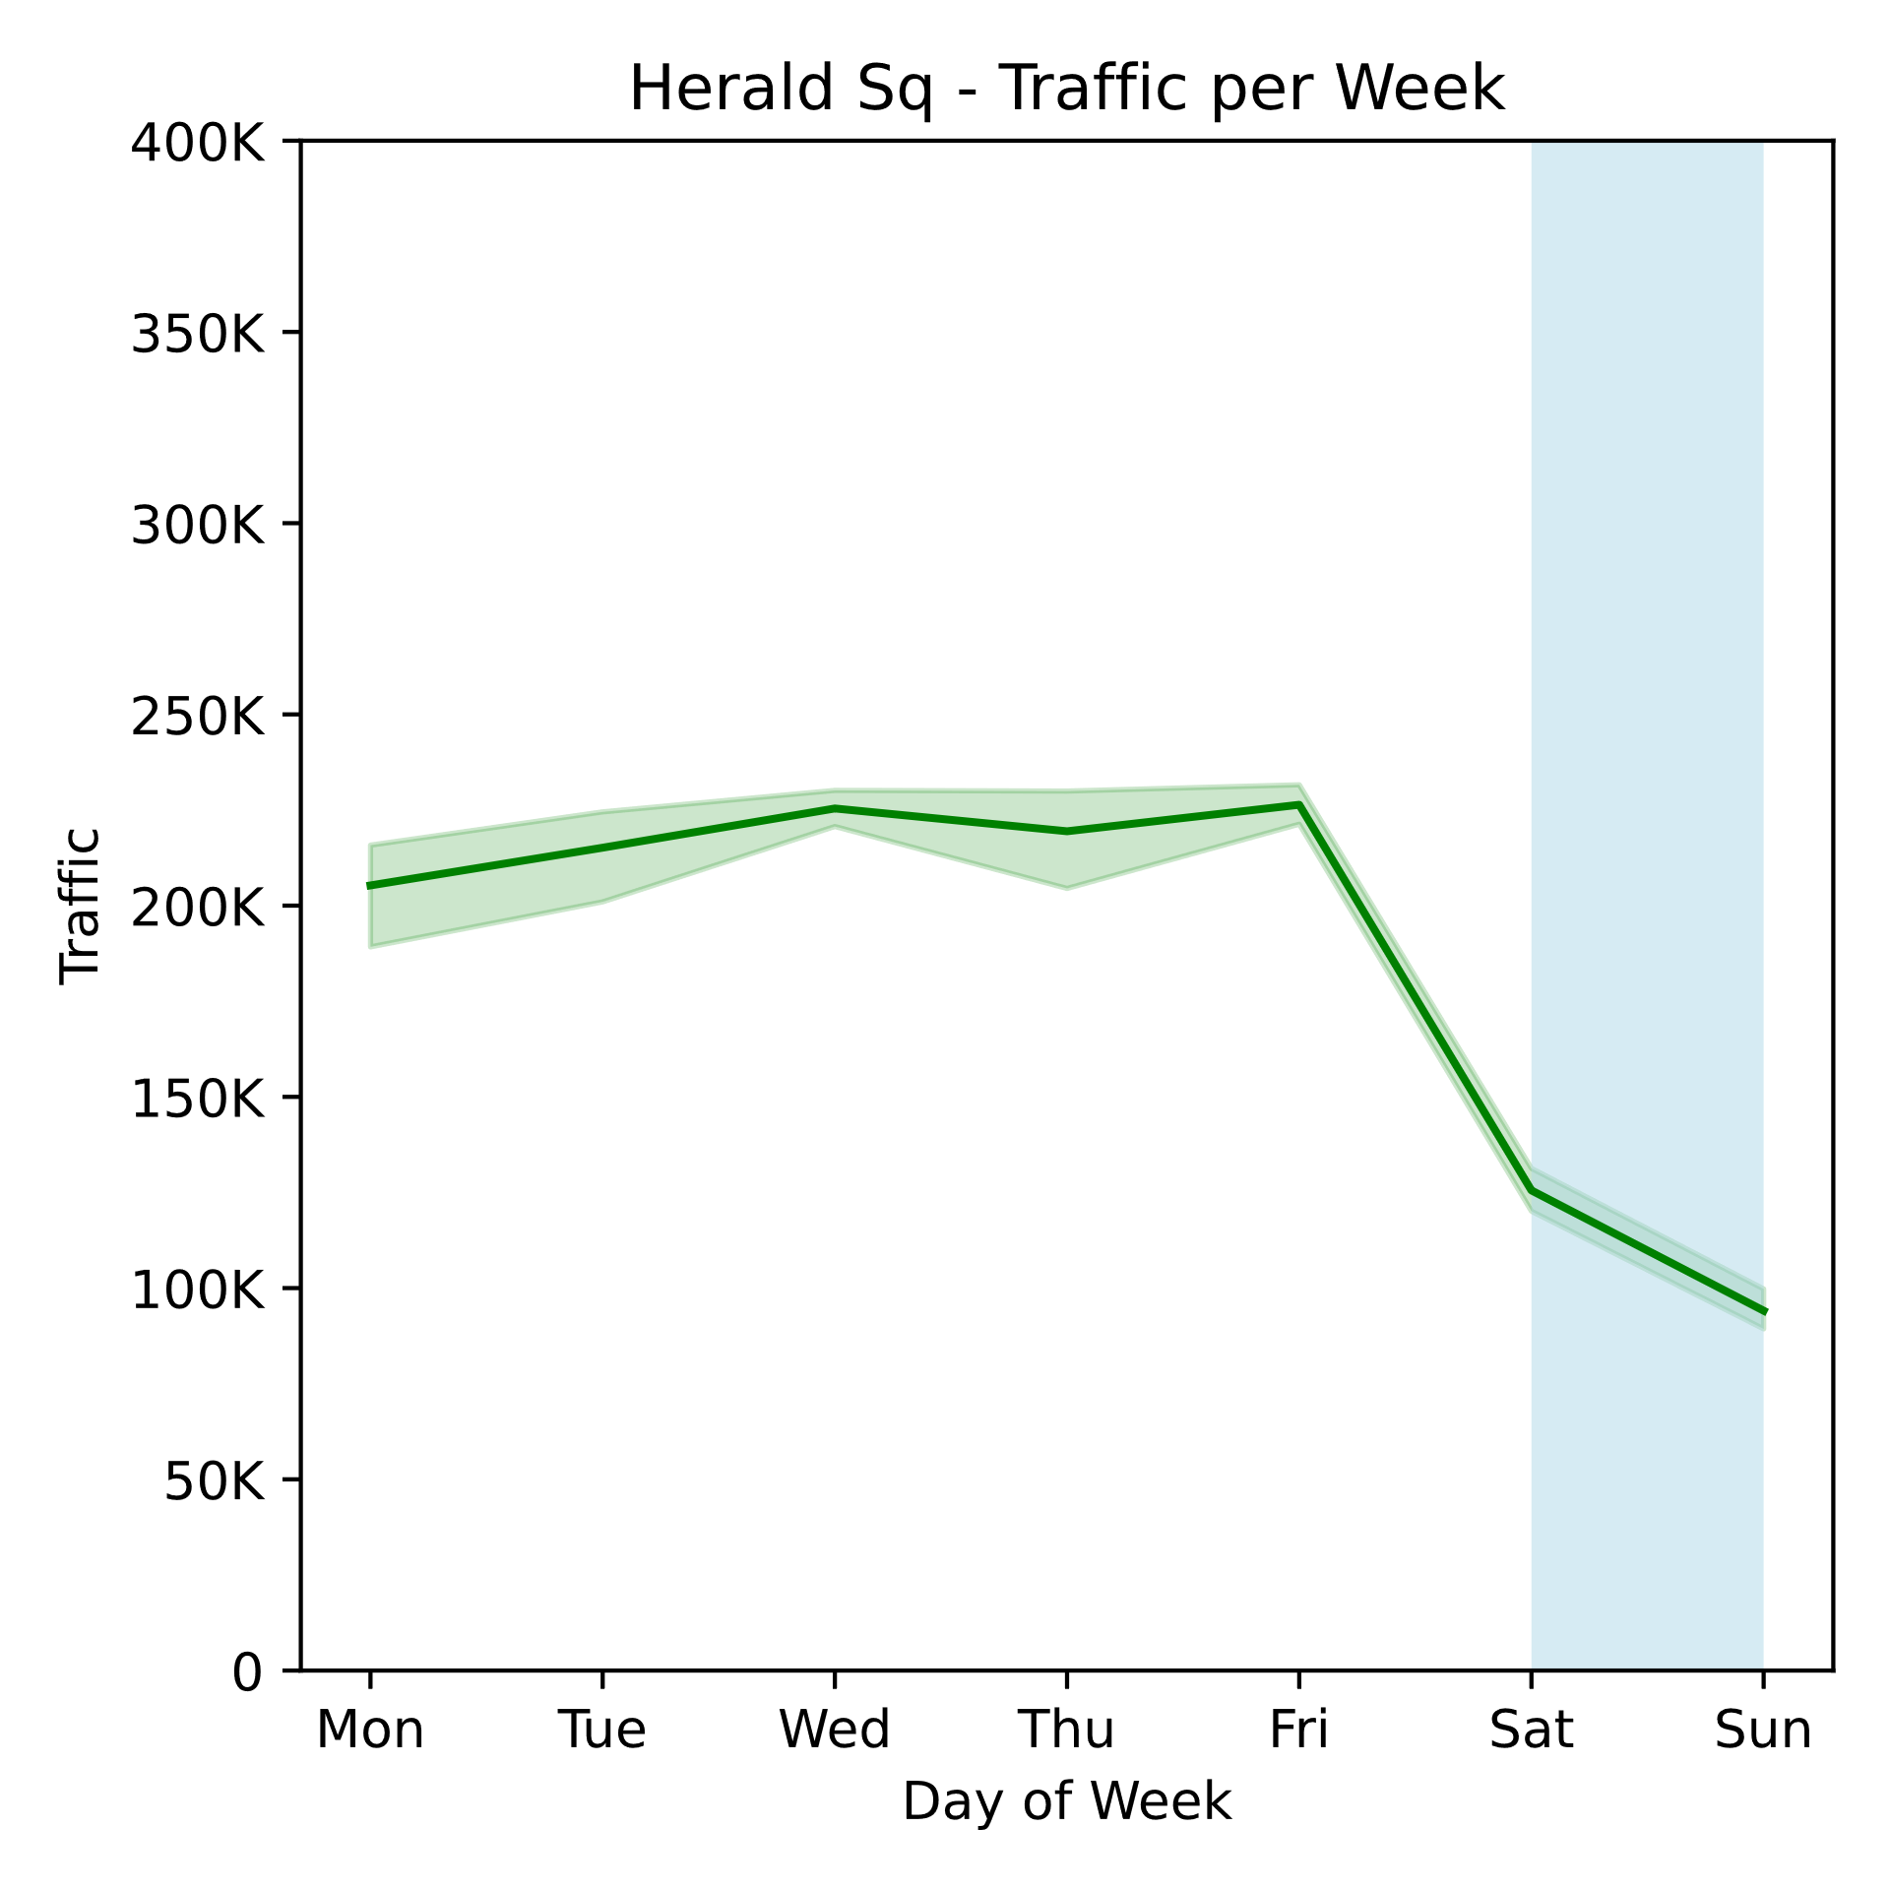
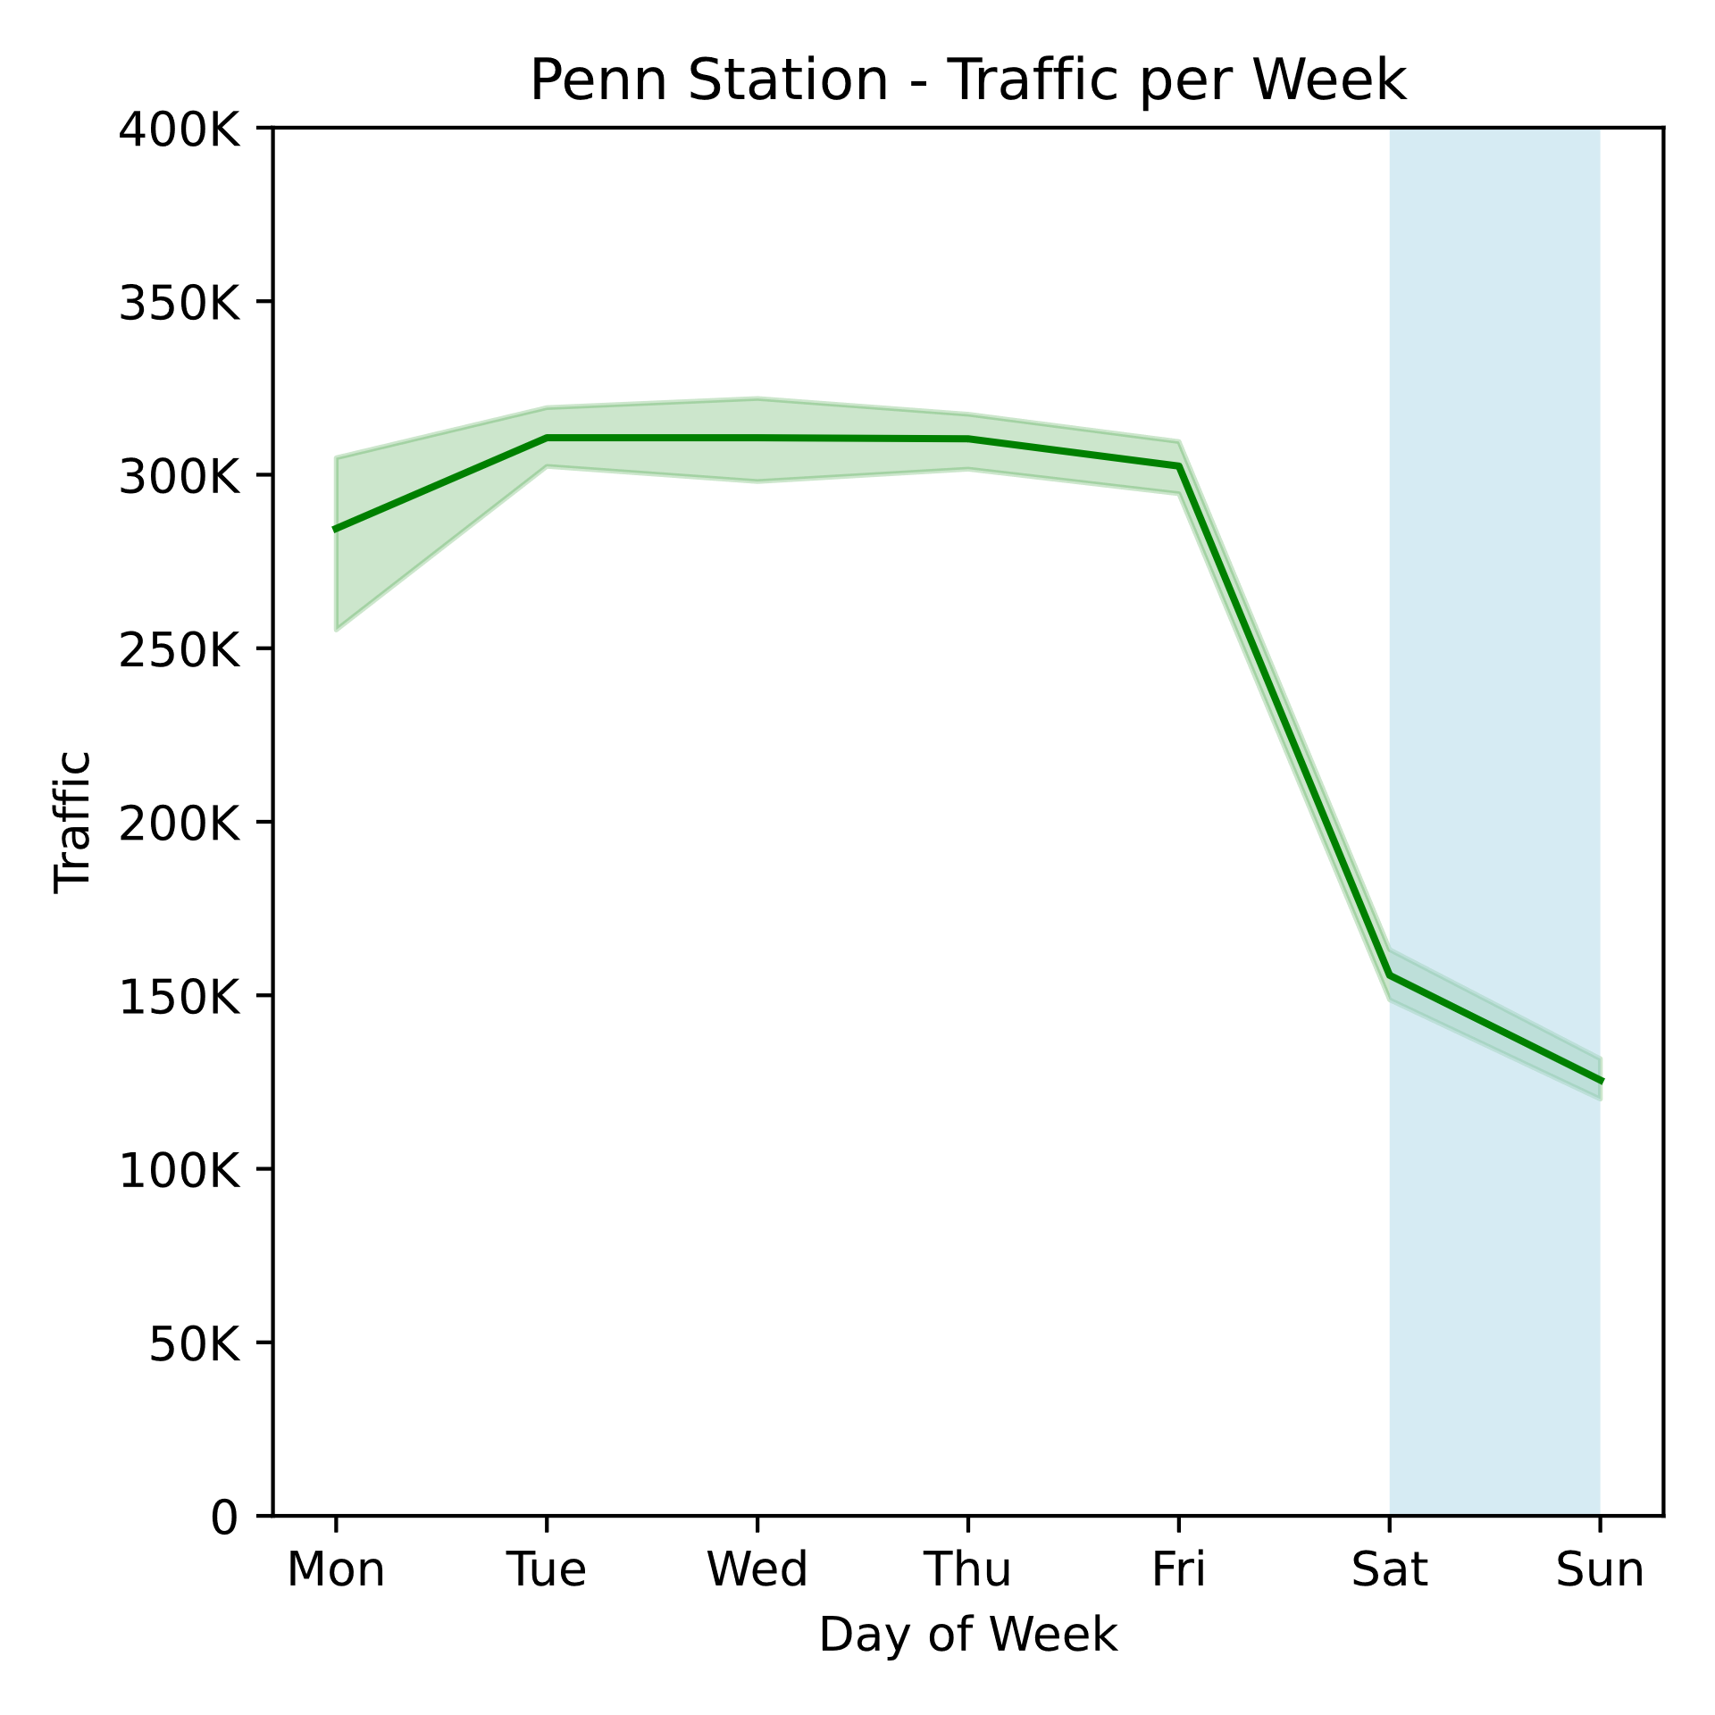
Appendix 1 (contd)

Slide 14
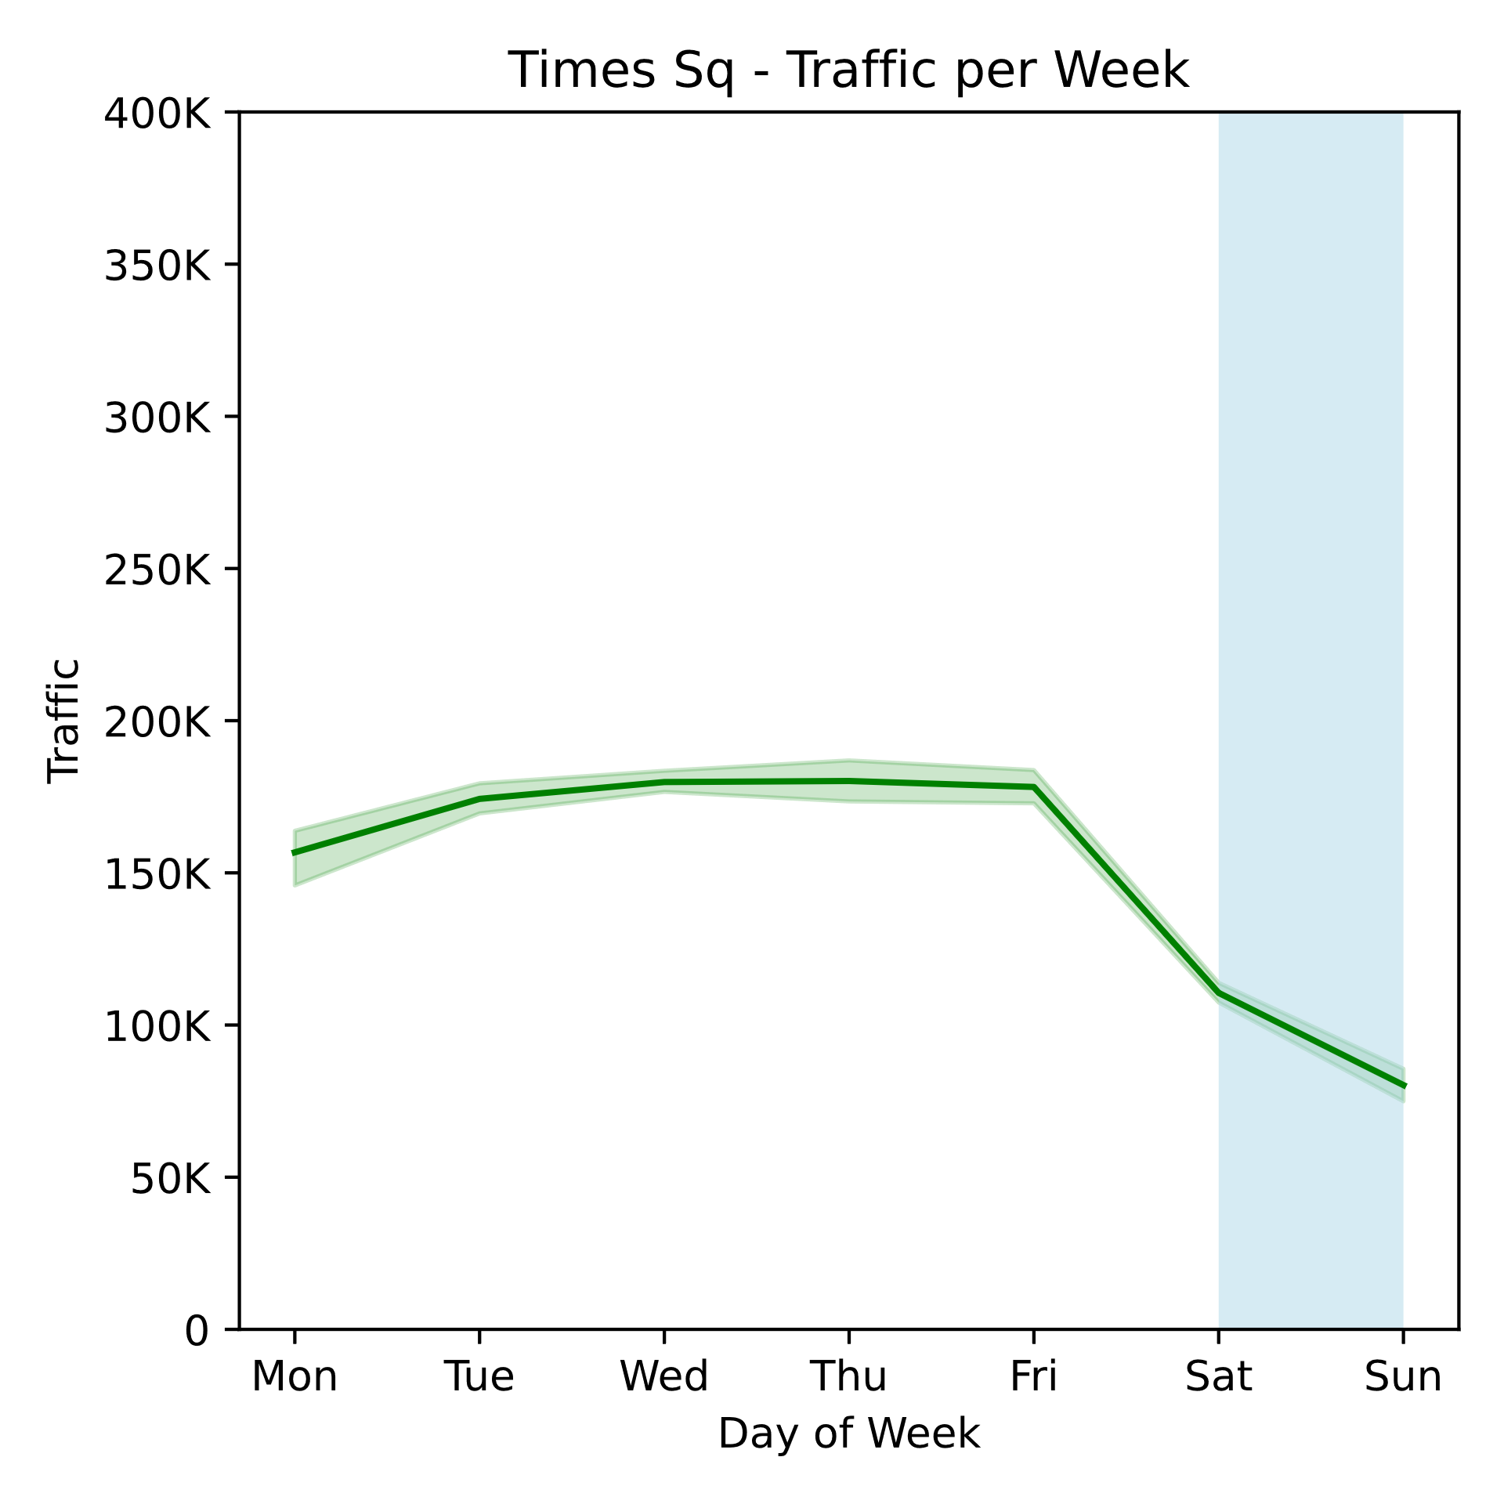
Appendix 1 (contd)

